Slide 1
SALES ANALYST SYSTEM
Team Members :
B.M.Krithik
Akshaya P L
Aaryan M

Slide 2
OBJECTIVE AND DOMAIN
Objective:
The primary objective of this Python project is to conduct a comprehensive sales analysis using the powerful data manipulation library, Pandas.
The project aims to extract meaningful insights from a dataset containing sales data, providing a detailed understanding of various aspects related to sales performance.
Domain:
Business intelligence and data analytics for sales management, particularly applicable to retail, e-commerce, and sales-driven industries.

Slide 3
Python:Python serves as the primary programming language for this project, offering readability and versatility in data analysis tasks.
Pandas:Pandas, a powerful data manipulation library, is utilized for data cleaning, preprocessing, and exploratory data analysis, providing efficient tools for handling and analyzing structured data.
NumPy:NumPy is employed for numerical operations and array manipulations, complementing Pandas functionalities in handling large datasets efficiently.
Matplotlib and Seaborn:Matplotlib and Seaborn are employed for data visualization, enabling the creation of insightful charts and graphs to represent trends, patterns, and insights uncovered during the analysis.
PROGRAMMING LANGUAGE AND PACKAGES USED

Slide 4
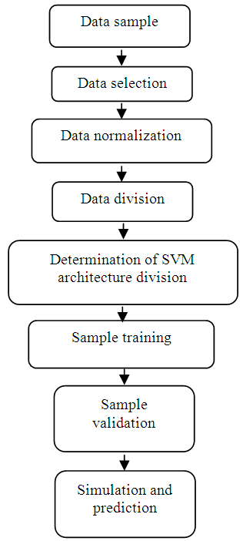
Architecture diagram
Sales Dataset
|
v
Data Ingestion --> Data Cleaning & Preprocessing --> Exploratory Data Analysis
| |
v v
Product Analysis <-- Customer Segmentation <-- Time-Series Analysis
| (Optional)
v
Geographical Analysis (Optional)
|
v
Machine Learning Module (Optional)
|
v
Jupyter Notebooks <-- Output/Insights

Slide 5
Module split up
Data Preparation Module:Task: Ingest and clean the sales dataset for analysis.Components:Data Ingestion (Retrieve data from source). Data Cleaning and Preprocessing (Handle missing values, outliers, data integrity)
Exploratory Data Analysis (EDA) Module:Task: Uncover insights and patterns within the sales dataset. Components:Descriptive statisticsData visualizations (Matplotlib and Seaborn)Trend analysis
Metrics and Insights Module:Task: Calculate key sales performance metrics and generate actionable insights. Components:Sales Performance Metrics CalculationProduct AnalysisCustomer Segmentation (Optional: Time-Series Analysis, Geographical Analysis, or Machine Learning)

Slide 6
THANK YOU

